Slide 1
HYPERSENSITIVITY REACTIONS
Wewedru I.

Slide 2
Introduction
Immune response mobilizes effector molecules to remove an antigen (Ag) by various mechanisms.
Effector molecules induce localized inflammatory response to eliminates Ag without extensive damage to host’s tissue.
Under certain conditions, this response may have deleterious effects/tissue damage.
An inappropriate immune response is termed ‘hypersensitivity’ or ‘allergy’.
This increased immune response may develop during either humoral or cell-mediated response.
Four types of hypersensitivities

Slide 3
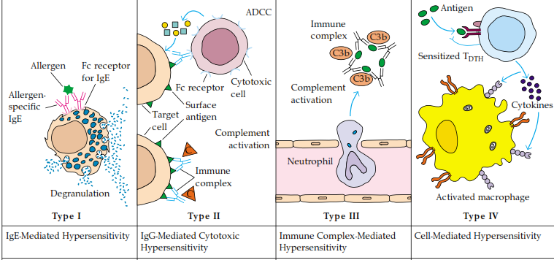
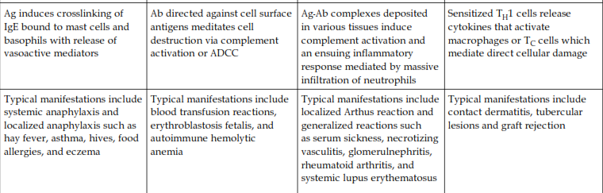

Slide 4
Type 1 hypersensivity:iG-G Mediated
Induced by allergens(antigens),
Allergen induce antibody response.
In this Ab response, the plasma cells produce IgE.
IgE binds with high affinity Fc receptors on Mast cells and Basophils.
Subsequent exposure to the same allergen cross-links the membrane bound IgE on the sensitized cells causing them to degranulate.
Released ‘active mediators’ ’act on the surrounding tissue casuing ‘vasodilation and smooth muscle contraction’ (systemic or localized).

Slide 5
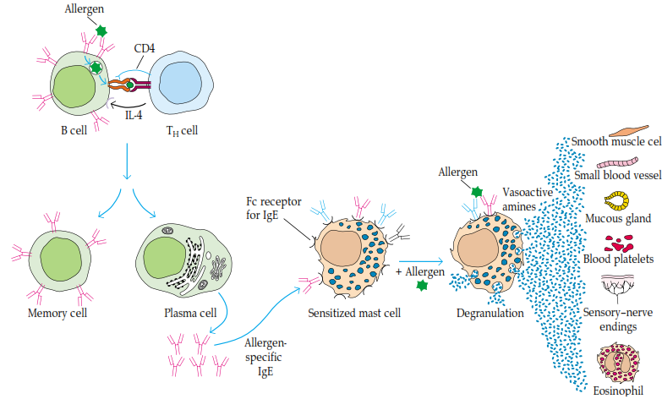
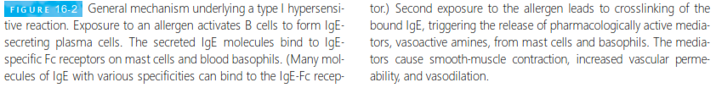

Slide 6
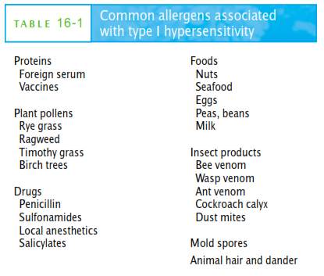

Slide 7
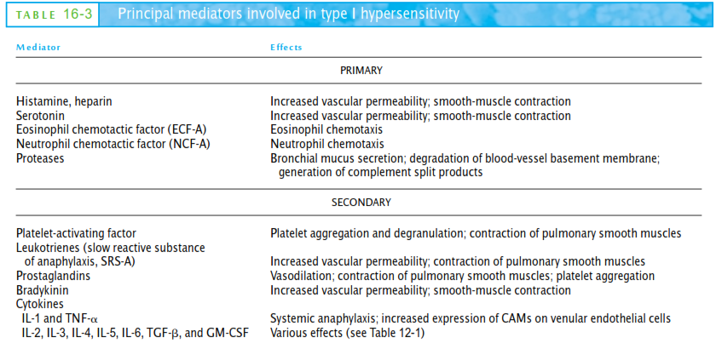

Slide 8
Type ii hypersensitivity: antibody-mediated cytotoxic
Involve antibody-mediated destruction of cells
Antibody activated complement system create pores in the membrane of foreign cell or mediate cell destruction by antibody-dependent cell-mediated cytotoxicity (ADCC).
Cytotoxic cells with Fc receptors bind the Fc region of the antibody on the target cells and promote the killing of the cells.
Antibody binds to foreign cell, serve as an opsonin, enabling phagocytic cells with Fc or C3b receptors to bind and phagocytose the antibody-coated cell.

Slide 9
Type iii hypersensitivity: immune complex-mediated
Antibody and antigen reaction generates immune complexes
Ag/Ab complexes facilitate the clearance Ag by phagocytic cells
Large amount and distribution of immune complexes can lead to tissue damage
Deposition of immune complexes near the site of Ag entry lead to localized reactions.
Complexes are usually deposited on blood vessel walls, synovial membrane joints, glomerular and choroid plexus of the brain.
Immune complex deposits lead to the recruitment of neutrophils at the site of Ag entry. Injury is due to enzymes released from neutrophil granules.
Immune complex can activate complement system to cause more tissue injury.

Slide 10
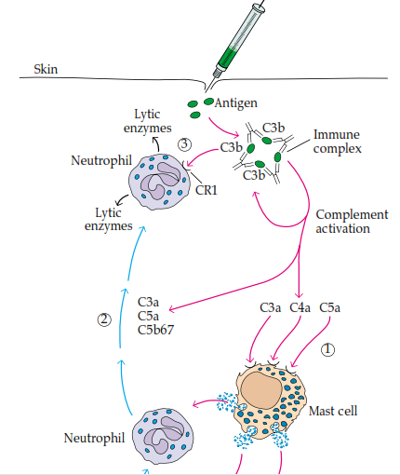
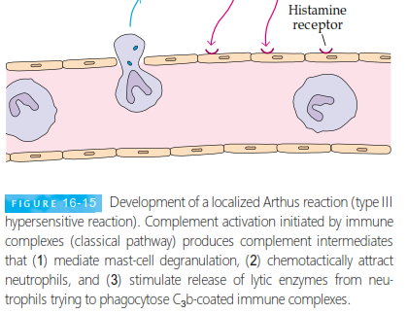

Slide 11
Type iv: Delayed type hypersensitivity (dth)
When some subpopulations of activated TH cells encounter certain Ag(s), they secrete cytokines that induce a localized inflammatory reaction (DTH).
Characterized by large influxes of nonspecific inflammatory cells, e.g.macrophages.
DTH was first described by Robert Koch in 1880, when he worked on MTB.
Response plays an important role in defense against intracellular pathogen.
In DTH the reaction is delayed and macrophages are recruited , unlike neutrophils in Type III Hypersensitivity.

Slide 12
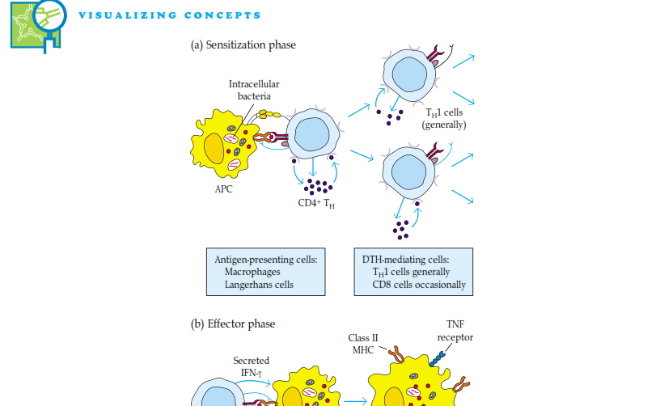
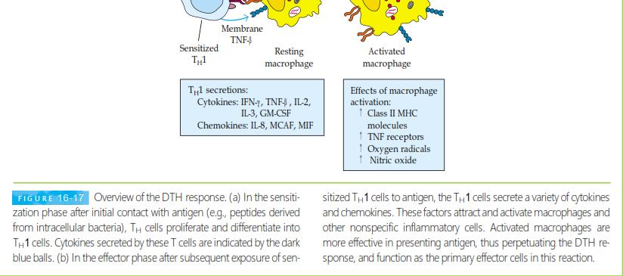

Slide 13
